Slide 1
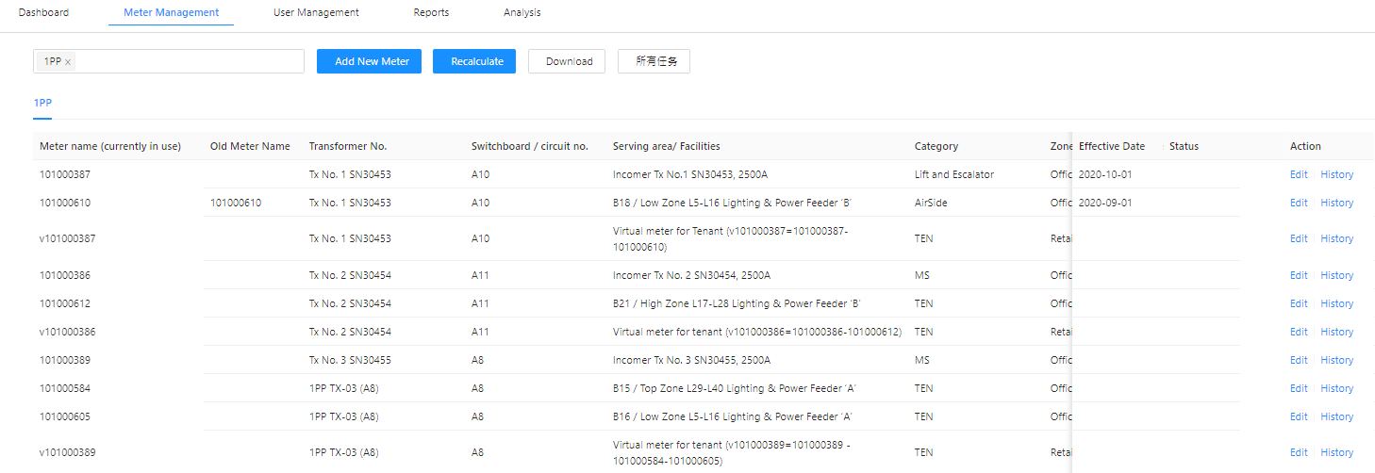
Task List
Add filter function

Slide 2
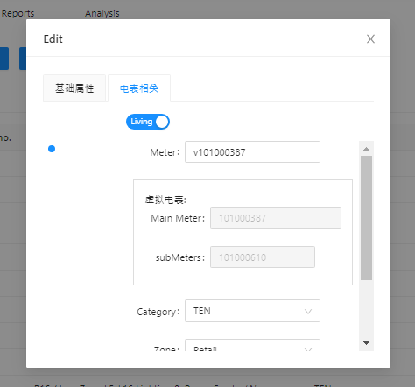
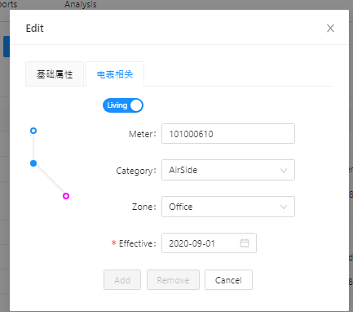
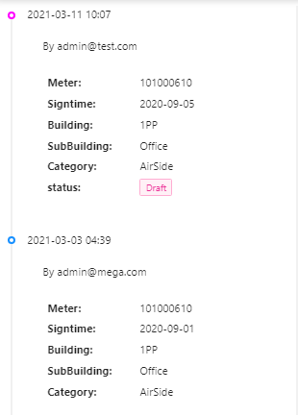
Add Legend:
Current calculation information
Drafted update
*Updates will be incorporated in the recalculation.
Description, Calculation Info
Meter status:
Live/ Dead
Effective Date
Zone
Virtual Meter
Effective Date
Add Remark:
Recalculation result shall be reflected from the next effective month.

Slide 3
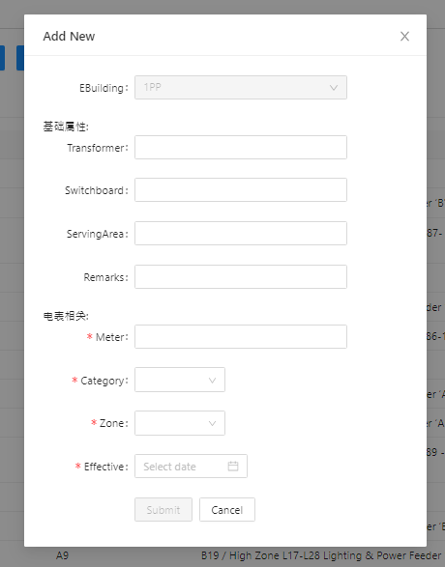
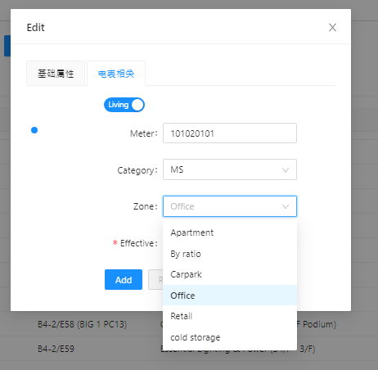
New meter
Building
Office
Retail
By ratio
Carpark
Apartment
Cold storage
Meter ID
Add icon “?”, click to display:
By ratio: refer to chiller plant meters of which consumption is shared by different users.
Please contact TSSD for any question.

Slide 4
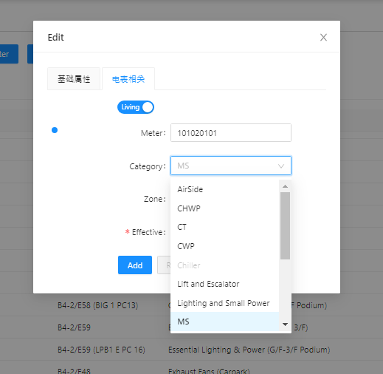
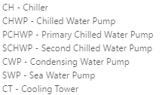
Category reorder:
AS
CH
CHWP
PCHWP
SCHWP
CWP
SWP
CT
L&P
L&E
OT
PD
TEN
MS
SM
Add icon “?”, click to display :
AS - Airside
L&P – Lighting & Small Power
L&E – Lift & Escalator
OT – Others
PD – Plumbing & Drainage
TEN – Tenant
MS - Main Switch
SM - Submain

Slide 5
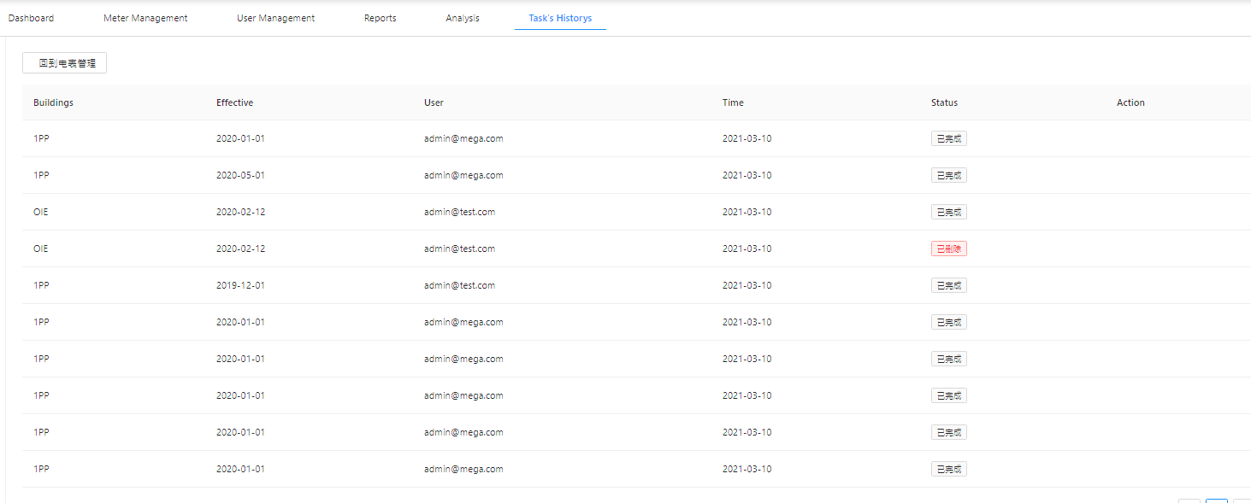
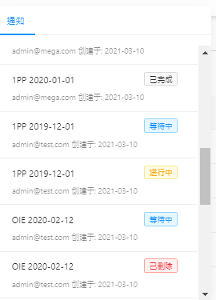
Task List
Notification
Back
Task Creation Date
Recalculation Start Date
Completed
Waiting
Calculating
Deleted
Display date&time

Slide 6
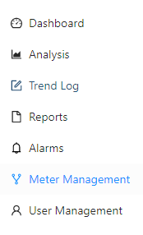



Use icons below

